Slide 1
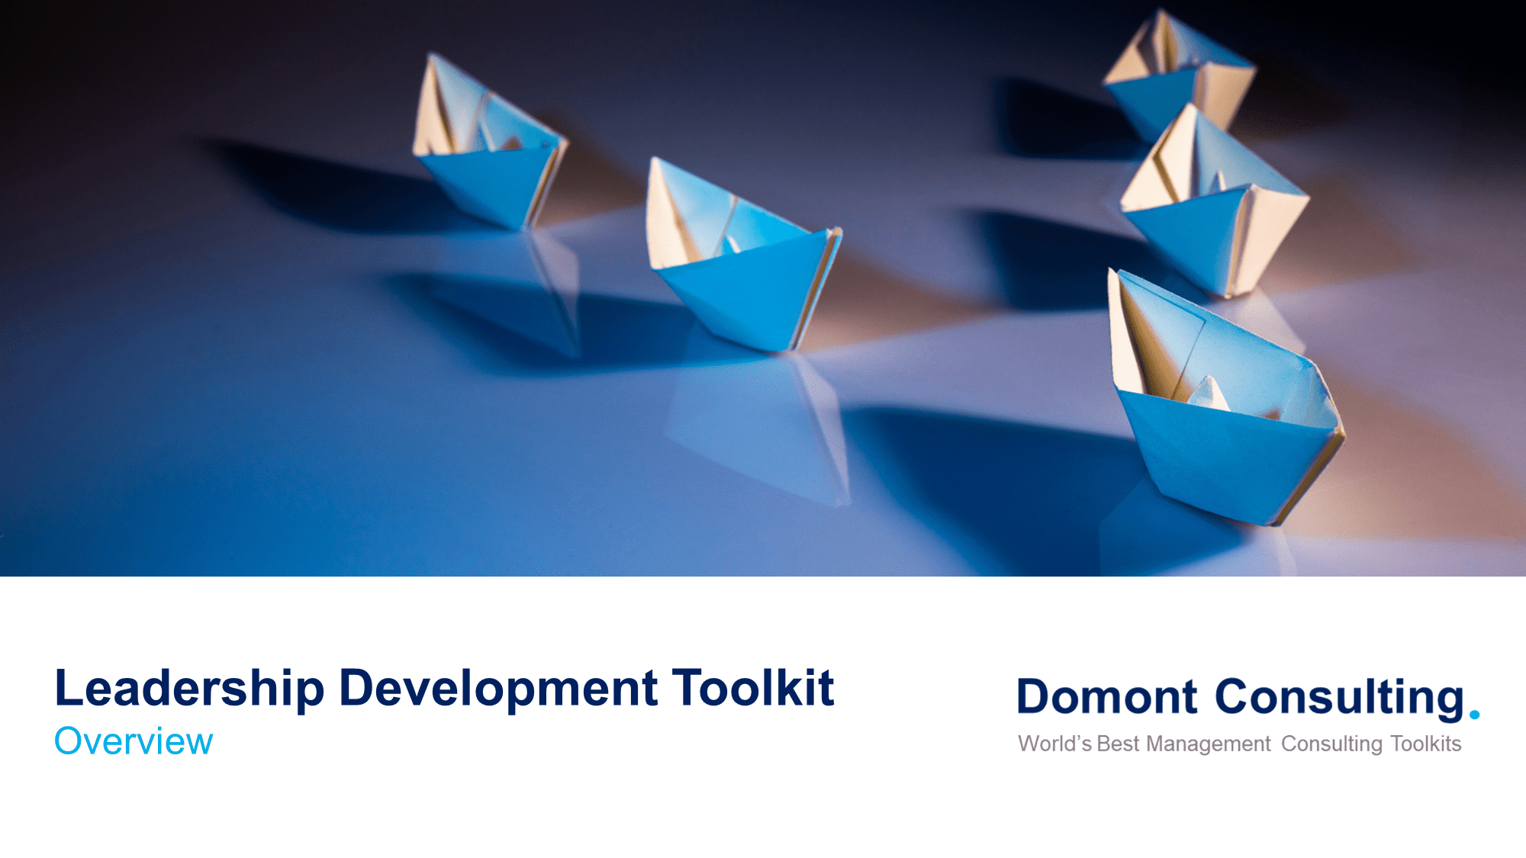
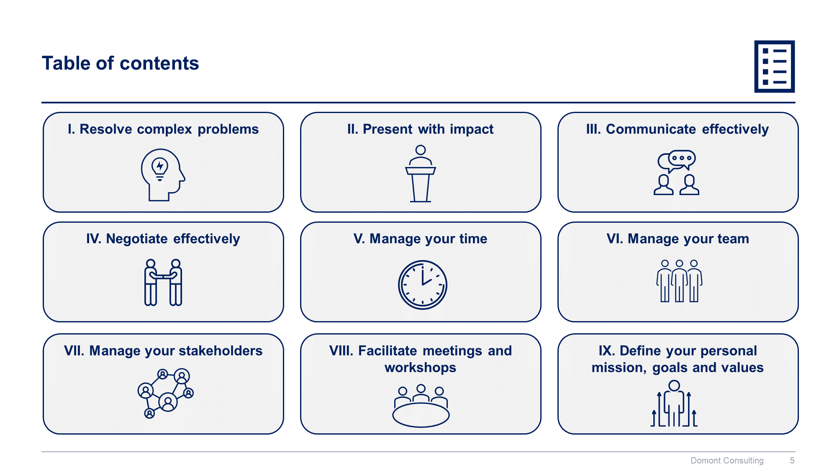
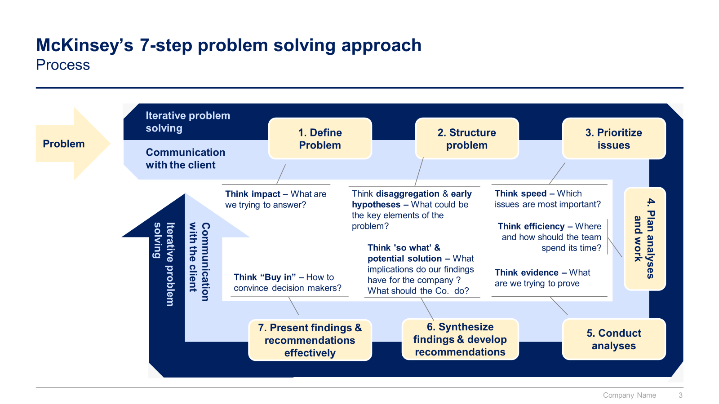
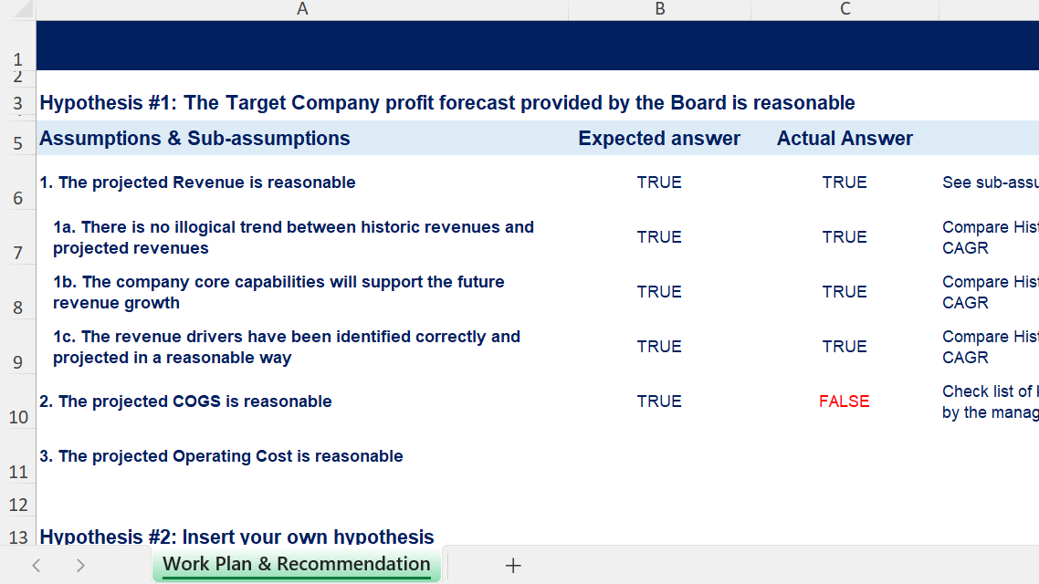
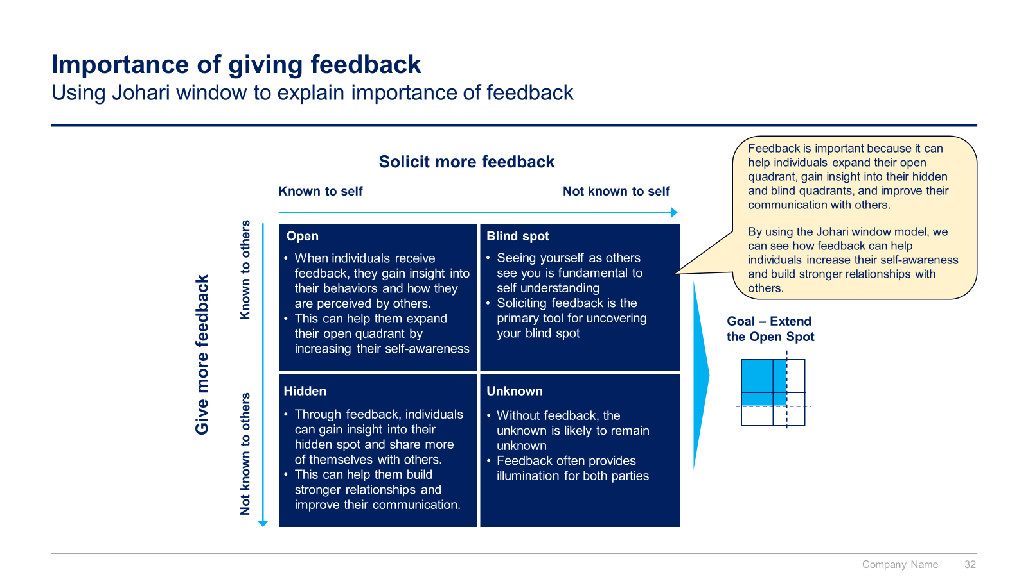
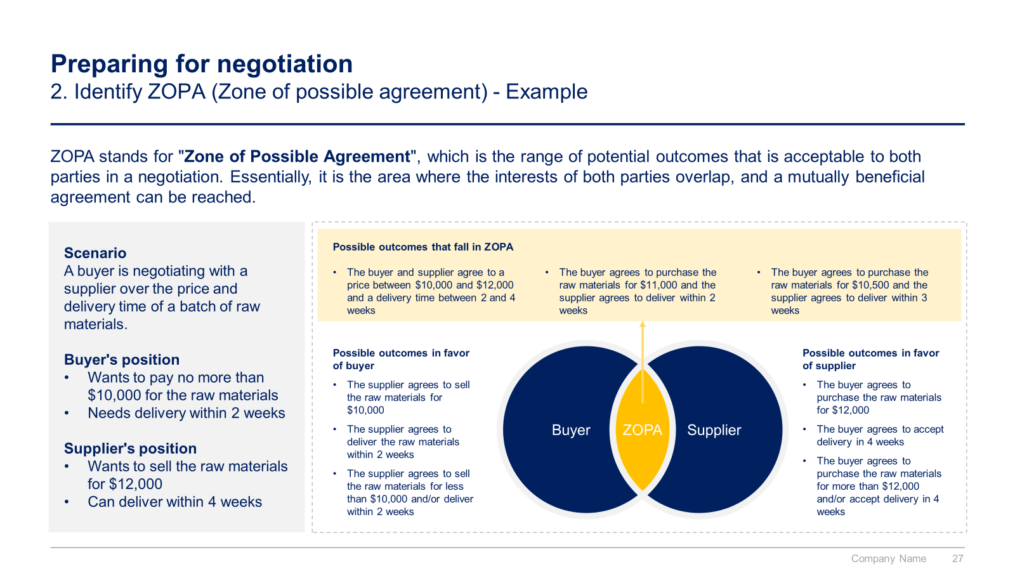
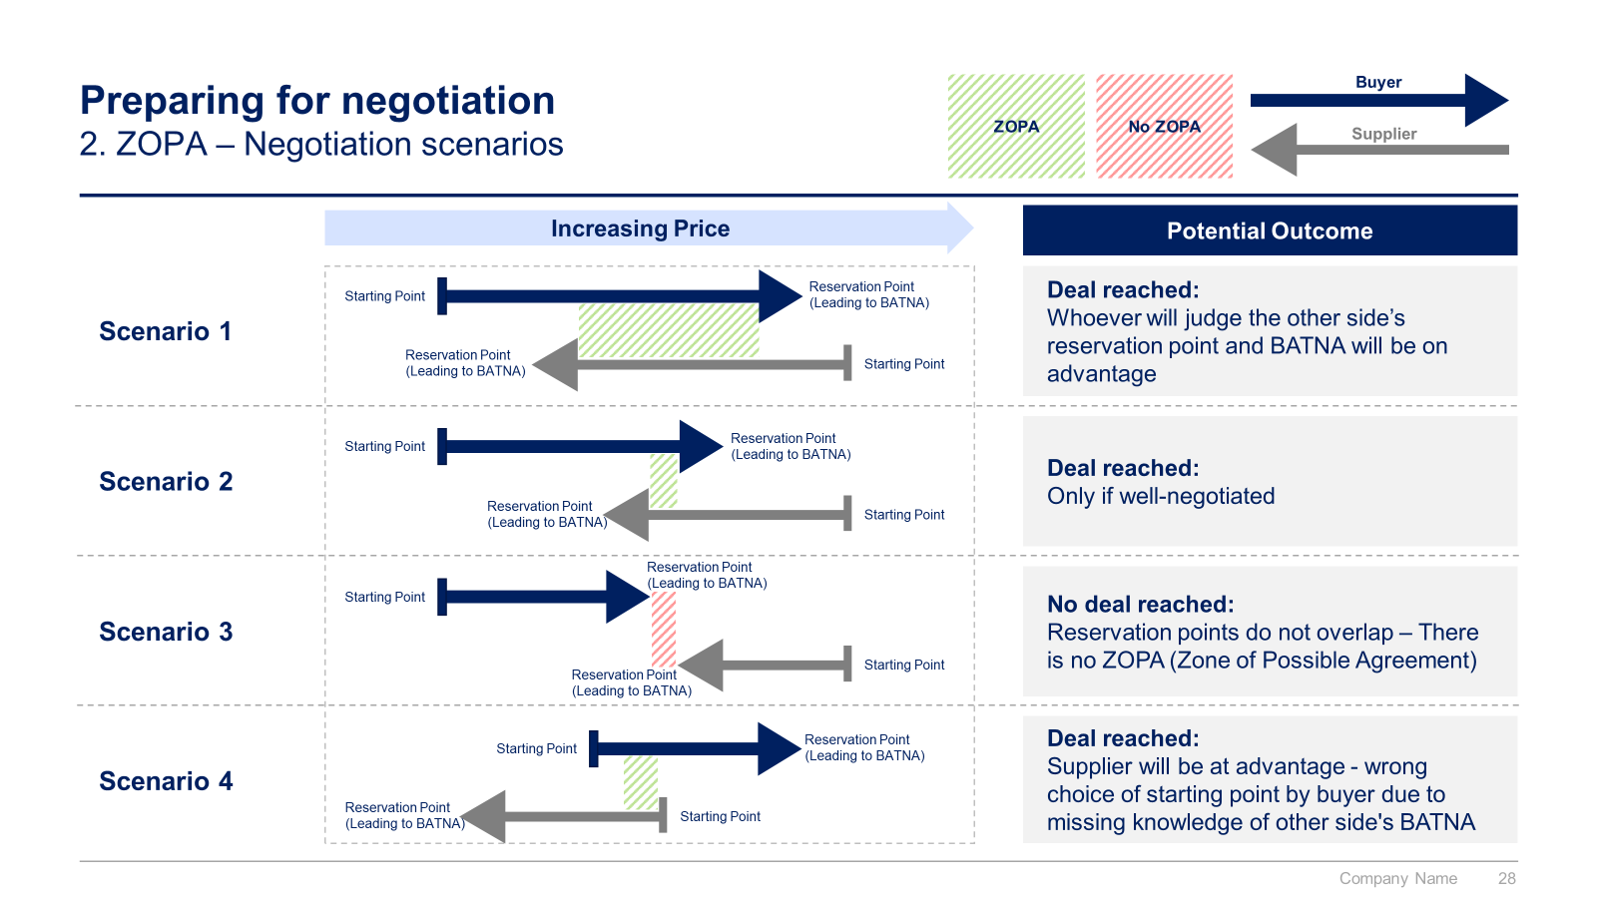
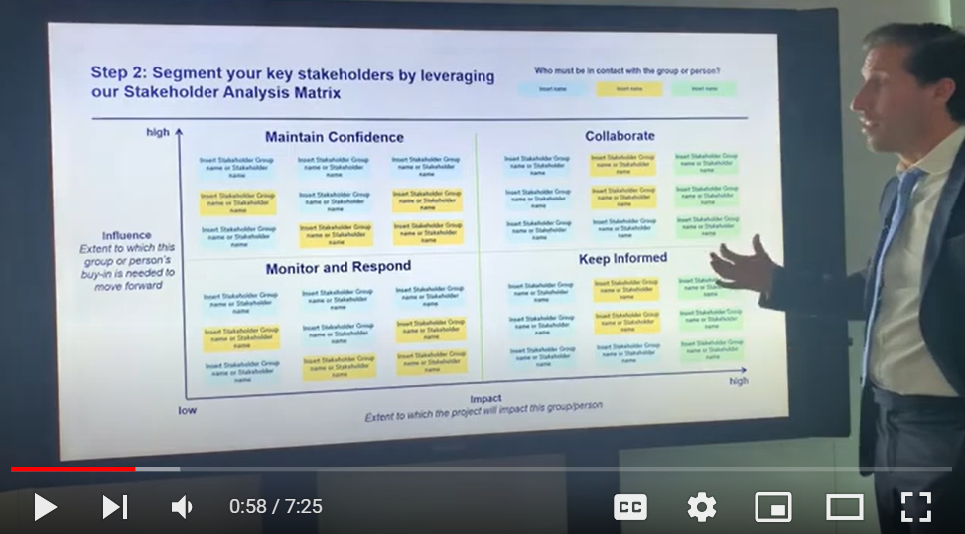
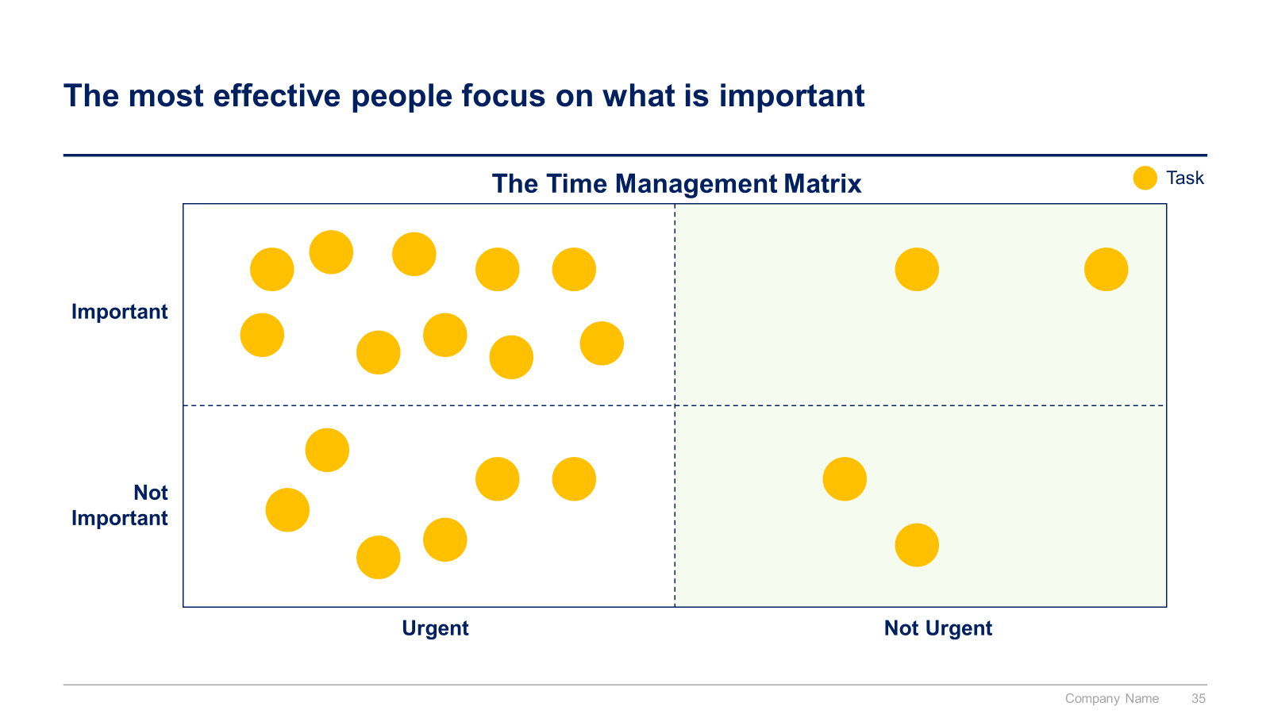

Slide 2


Leadership Development Toolkit
Overview

Slide 3


Introduction
This Toolkit was created by ex-McKinsey, Deloitte & BCG Management Consultants specialized in Leadership Development. It will help you (I) Resolve complex problems, (II) Present with impact, (III) Communicate effectively, (IV) Negotiate effectively, (V) Manage your time, (VI) Manage your team, (VII) Manage your stakeholders, (VIII) Facilitate meetings and workshops, and (IX) Define your personal mission, goals and values. This Toolkit was used to train the leadership team and the managers of multiple Fortune Global 1000 firms.
Join the 200,000+ Executives, Consultants & Entrepreneurs who are already leveraging our Management Consulting Toolkits to improve the performance of their organization and boost their own career.
If you have any questions, send us an email at support@domontconsulting.com and one of our ex-McKinsey, Deloitte & BCG Management Consultants will get back to you within 2 business days.
Aurelien Domont
Management Consultant
Domont Consulting Managing Director

Slide 4












Our ex-McKinsey, Deloitte & BCG consultants created a Leadership Development Toolkit to train yourself or your leadership team
What’s inside the Toolkit?
Who created the Toolkit?
The Toolkit was created by former McKinsey, Deloitte & BCG management consultants.
Best Practices
Frameworks
Number of professionals leveraging our Toolkits
Advice from
tier-1 Management Consultants
Tools
There are 200,000+ Executives, Consultants & Entrepreneurs leveraging our Toolkits to improve the performance of their organization.
Real-life Examples
Templates
Trusted by small and large organizations
Video Training
Step-by-step Tutorials

Slide 5
Our Toolkit will help you fulfill multiple objectives
The Leadership Development Toolkit includes frameworks, tools, templates, tutorials, real-life examples, video training, and best practices to help you:
Resolve complex problems: (1) Define problem, (2) Structure problem, (3) Prioritize issues, (4) Plan analyses and work, (5) Conduct analyses, (6) Synthesize findings & develop recommendations, (7) Present findings & recommendations effectively.
Present with impact: (1) Showing strong personal presence, (2) Importance of gestures, (3) Collaborative approach to presenting, (4) The “3 Cs” of engaging communications.
Communicate effectively: (1) Listen effectively, (2) Avoid verbal “communication killers” & use verbal “communication openers”, (3) Use non-verbal communication efficiently, (4) Do your homework prior to a real conversation, (5) Give and receive feedback, (6) Encourage the person to continue to talk and tell their story, (7) Check that you’ve understood the other person’s position, (7) Use open and closed questions smartly, (8) Communicate differently depending on the person’s style.
Negotiate effectively: (1) Preparing for negotiation, (2) Conducting negotiation, (3) Closing negotiation.
Manage your time: (1) Have a very well-organized filing system, (2) Avoid procrastination, (3) Avoid being interrupted and distracted to reach a state of high productivity, (4) Avoid ineffective meetings, (5) Master efficient tools such as Outlook, (6) Never start from scratch, (7) Know how to prioritize.
Manage your team: (1) Build trust among your team, (2) Define your team’s mission, vision, and values, (3) Define your team’s key goals, (4) Define the key roles and responsibilities, (5) Define the ways of working, (6) Create a one-page team charter with your team, (7) Know how to coach your team members, (6) Role model a “constructive” culture, (7) Manage change
Manage your stakeholders: (1) List stakeholders who can influence your project or be impacted by it, (2) Segment your key stakeholders, (3) Define & implement a plan of actions for each stakeholder.
Facilitate meetings and workshops: (1) Create a foundation for collaboration, (2) Keep the discussion from going off track, (3) Get the discussion back on track .
Define your personal mission, goals and values: (1) Define your personal mission statement and vision statement, (2) Define your long-term and short-term goals, (3) Define your behaviors and values, (4) Create your personal development poster.

Slide 6

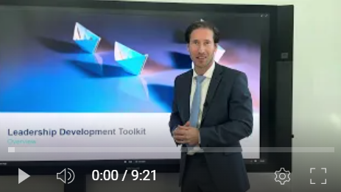
Video demonstration of the Leadership Development Toolkit
Video Demo Access
Video Demo Visual
Select “Slide Show” mode and then click on the link below or on the image on the right to access this video demo.
You can also access the video by copy pasting the following URL in your browser:
https://youtu.be/SOTenMnKvwQ

Slide 7






Table of contents
I. Resolve complex problems
II. Present with impact
III. Communicate effectively
IV. Negotiate effectively
V. Manage your time
VI. Manage your team
VII. Manage your stakeholders
VIII. Facilitate meetings and workshops
IX. Define your personal mission, goals and values

Slide 8
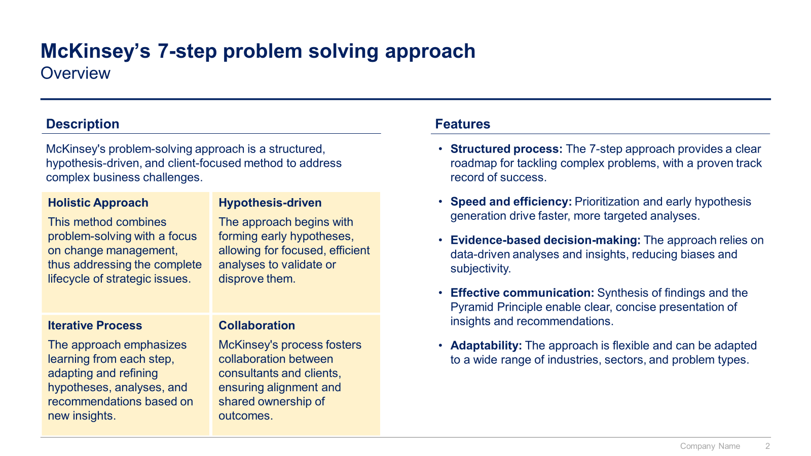
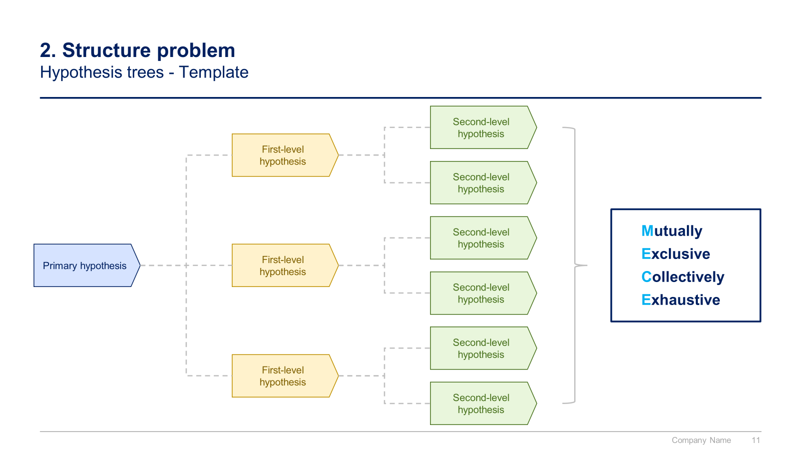
Small preview of the section “I. Resolve complex problems”

Slide 9
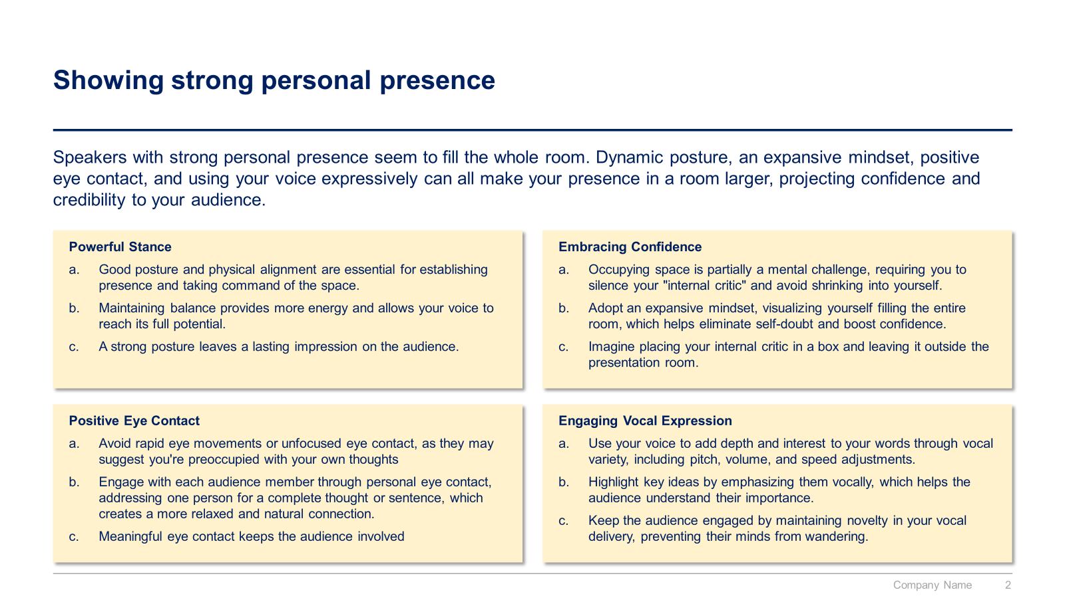
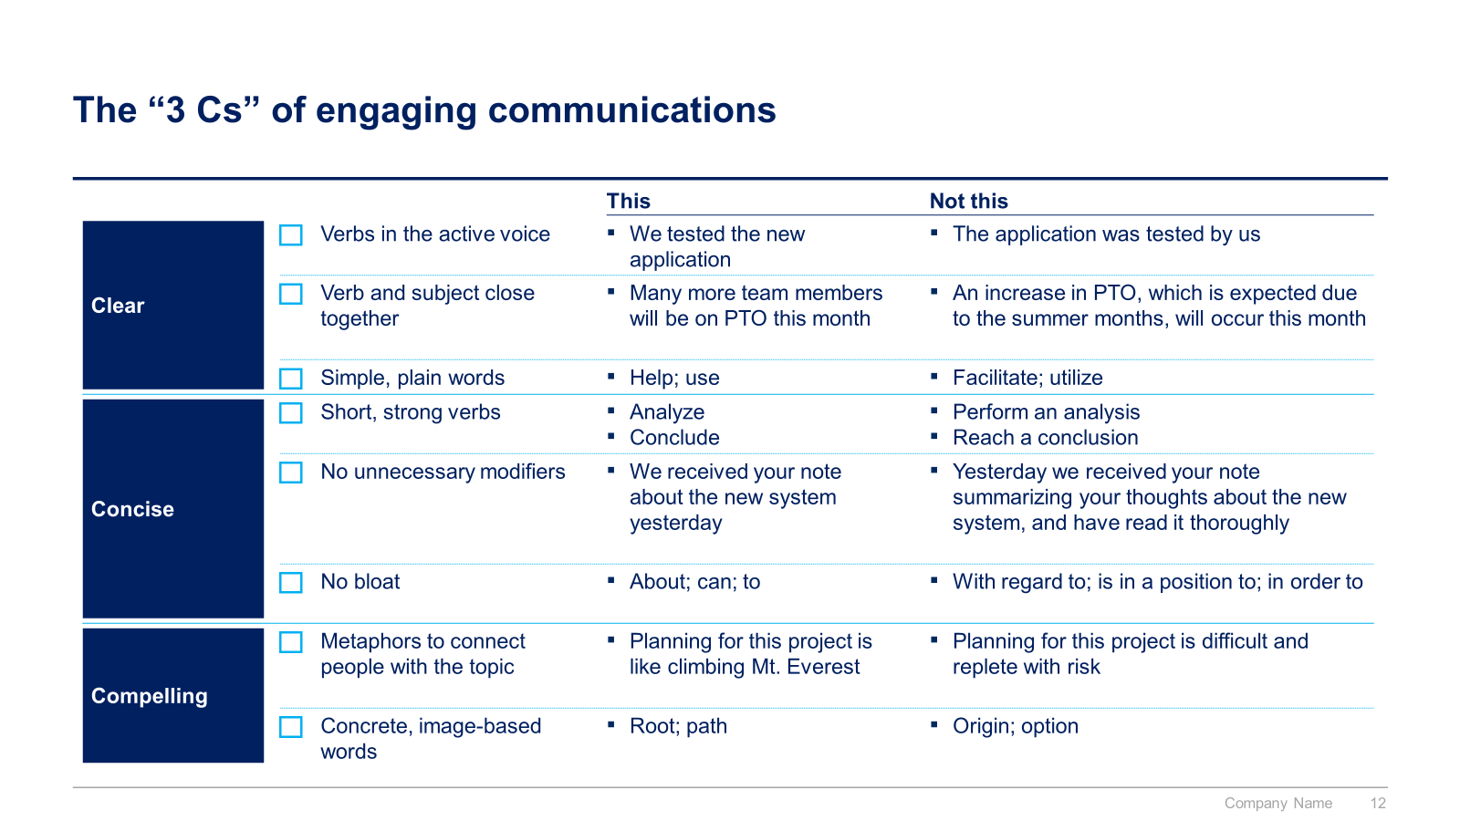
Small preview of the section “II. Present with impact” and “III. Communicate effectively”

Slide 10
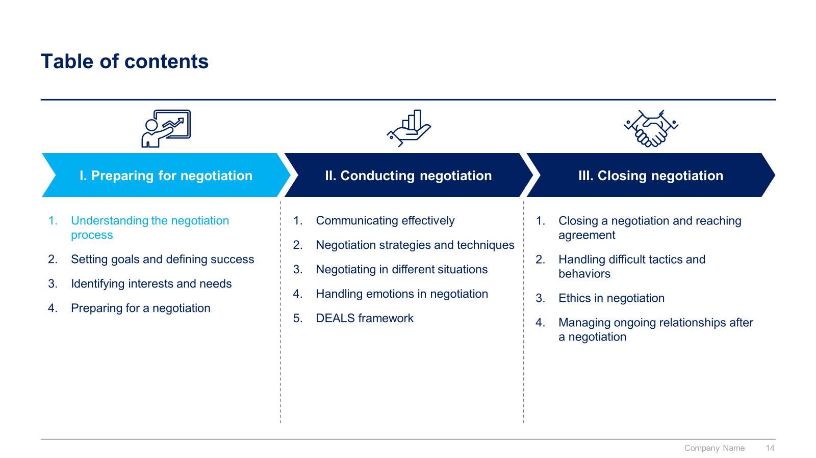
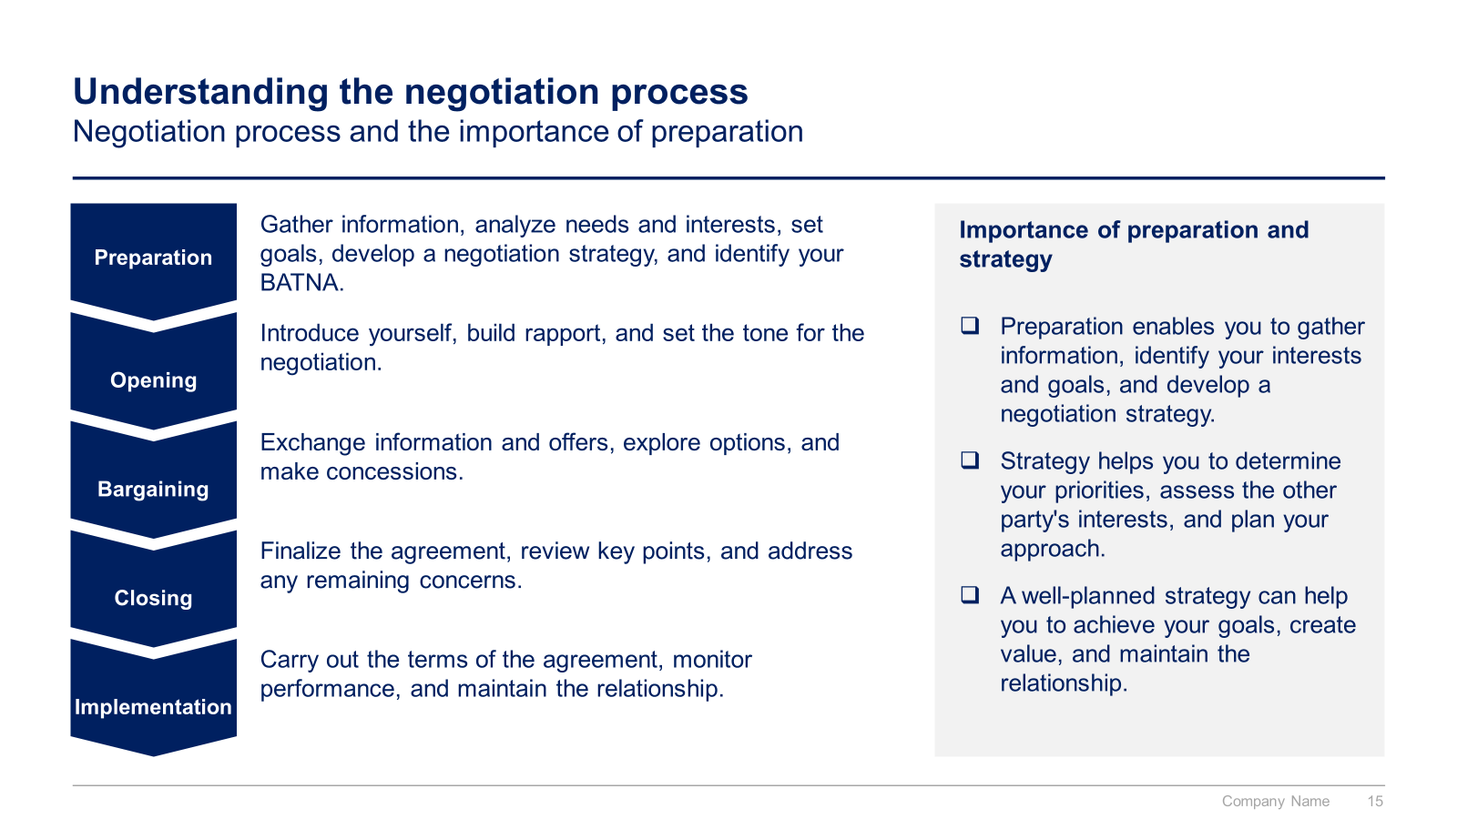
Small preview of the section “IV. Negotiate effectively”

Slide 11
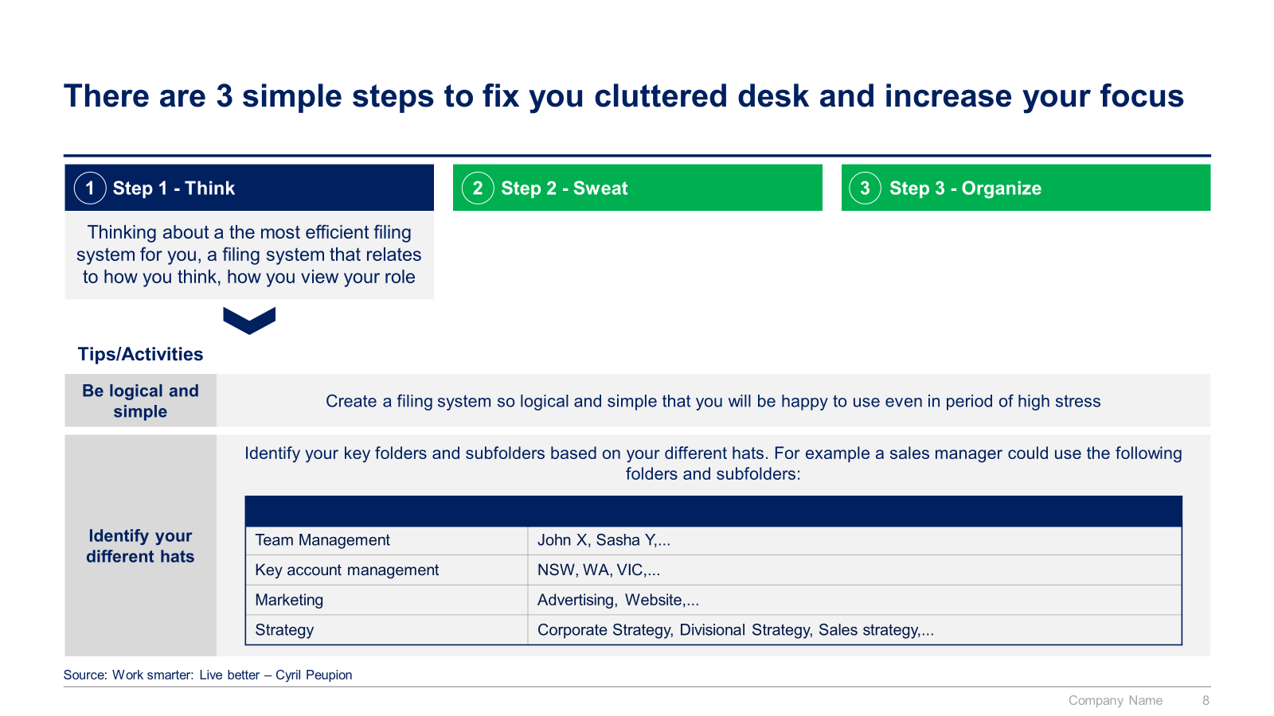
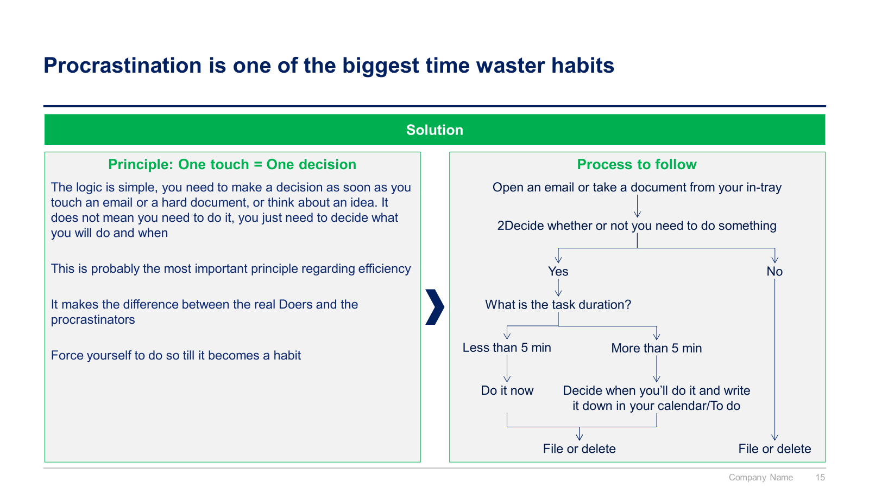
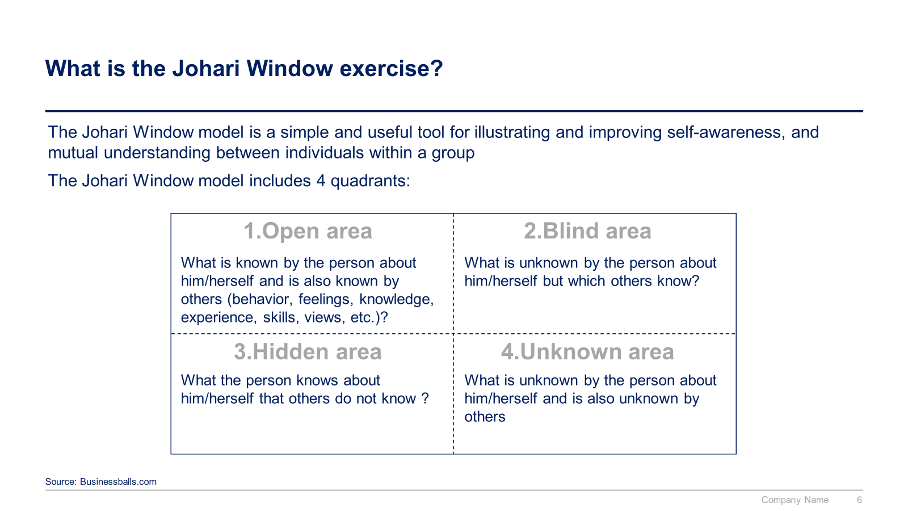
Small preview of the sections “V. Manage your Time” and “VI. Manage your Team”

Slide 12
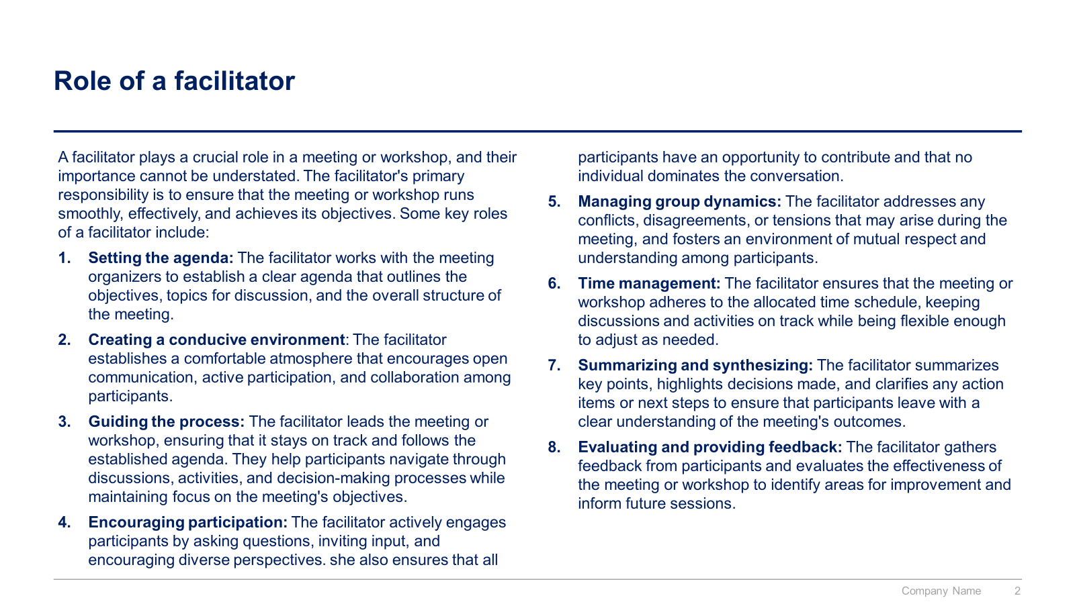
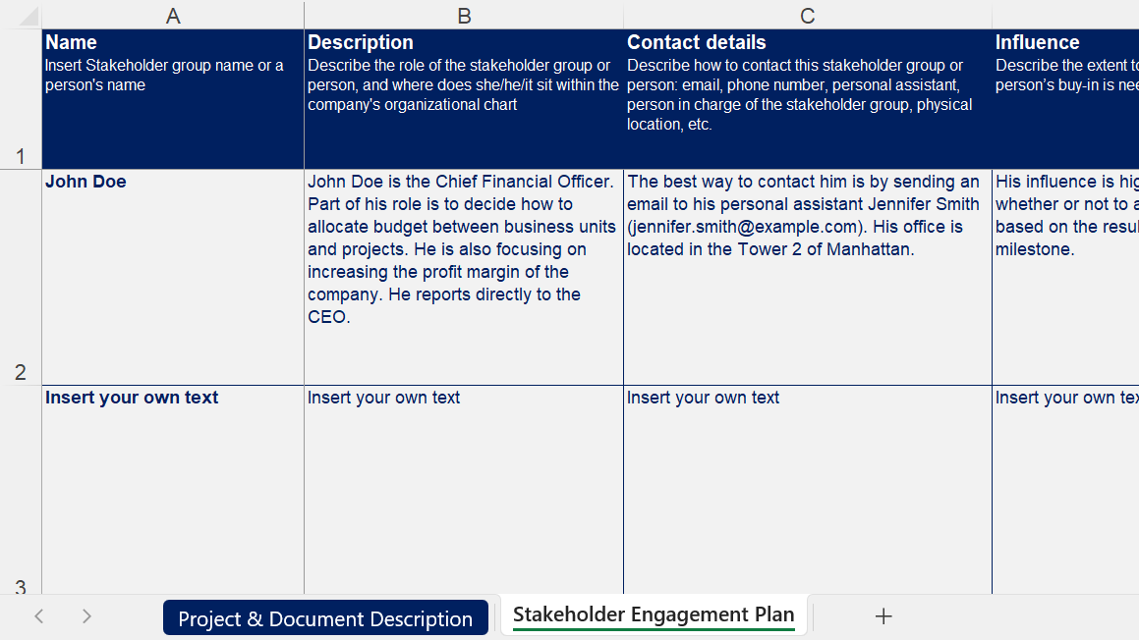
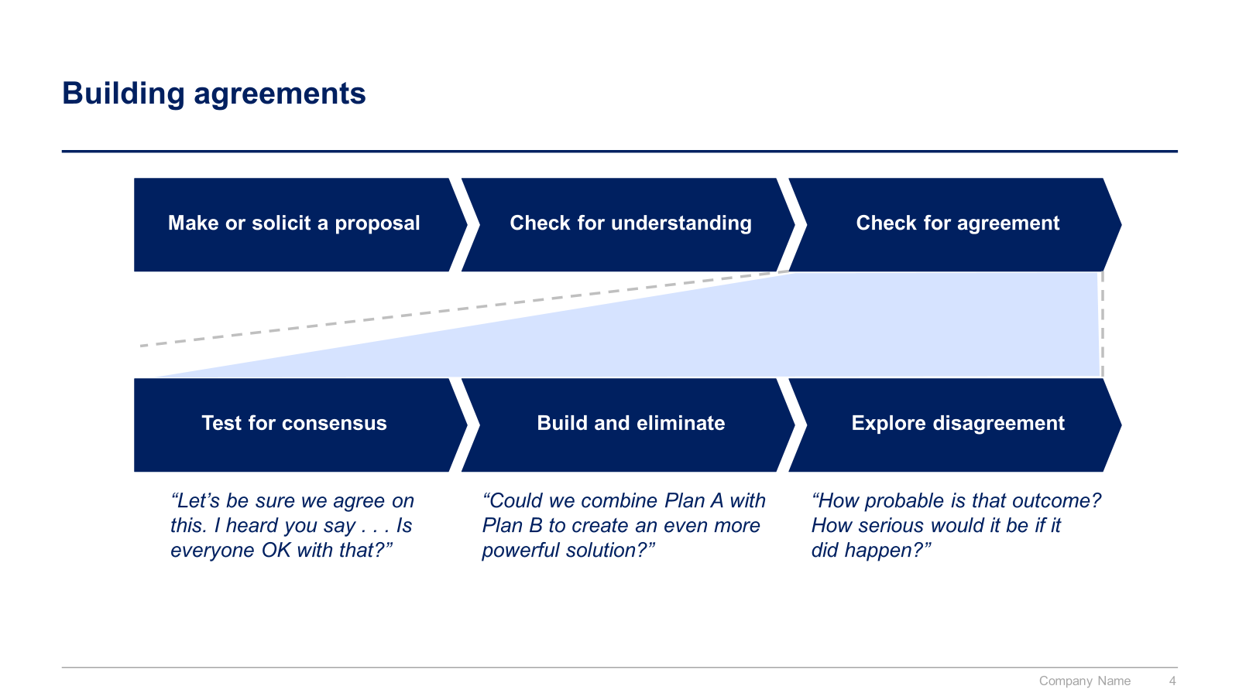
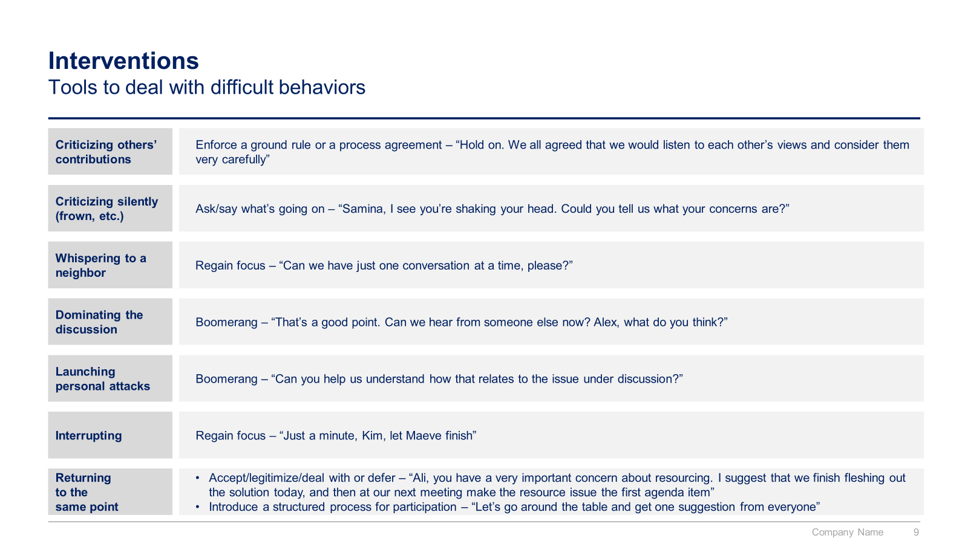
Small preview of the sections “VII. Manage your stakeholders” and “VIII. Facilitate meetings and workshops”

Slide 13
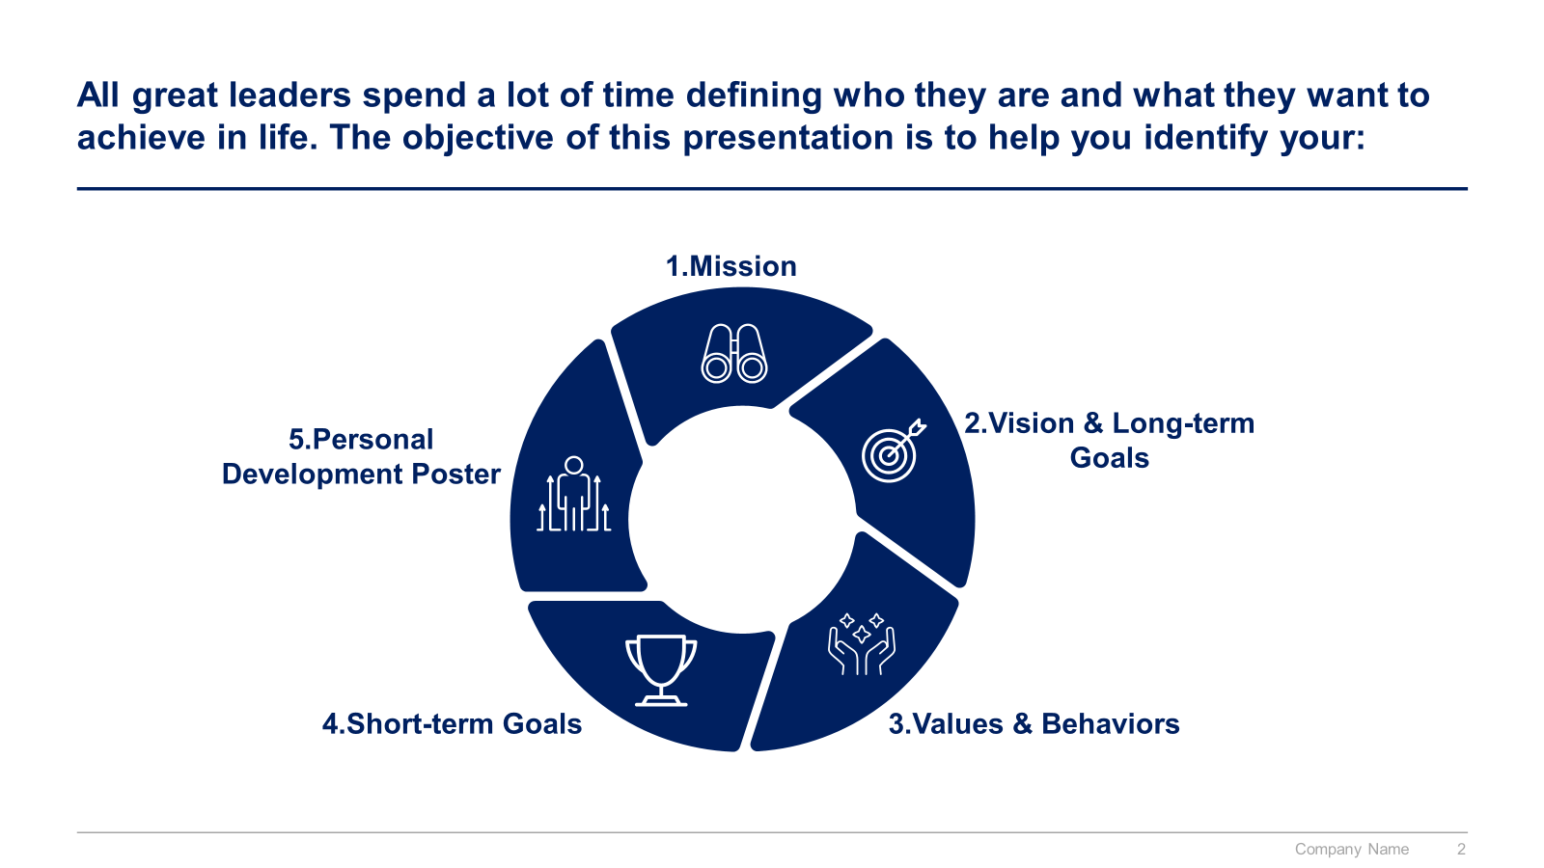
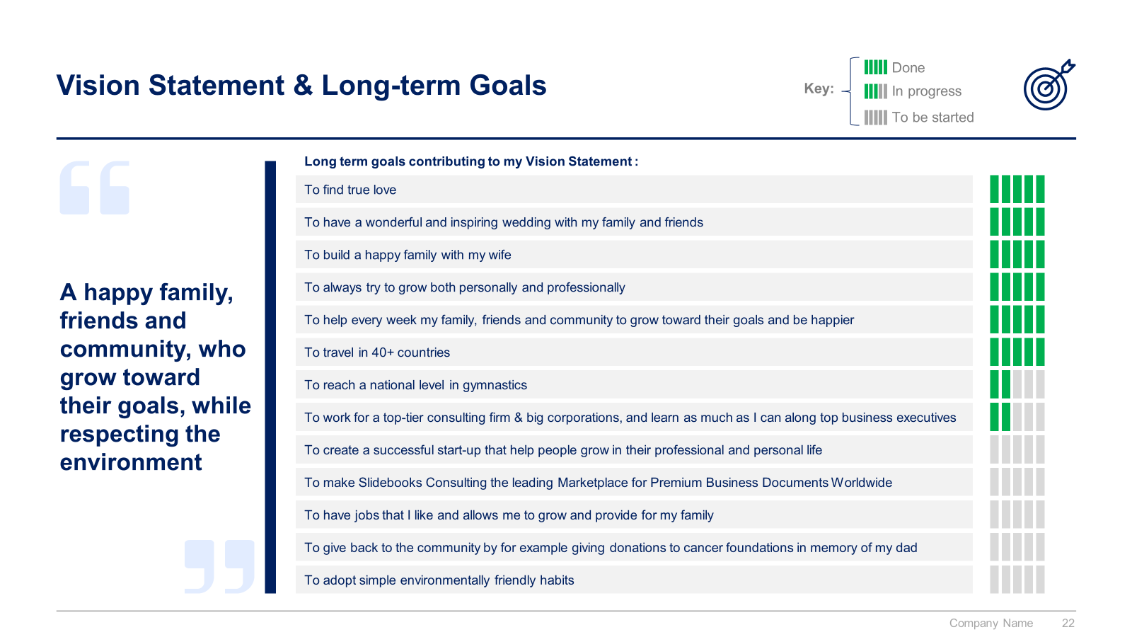
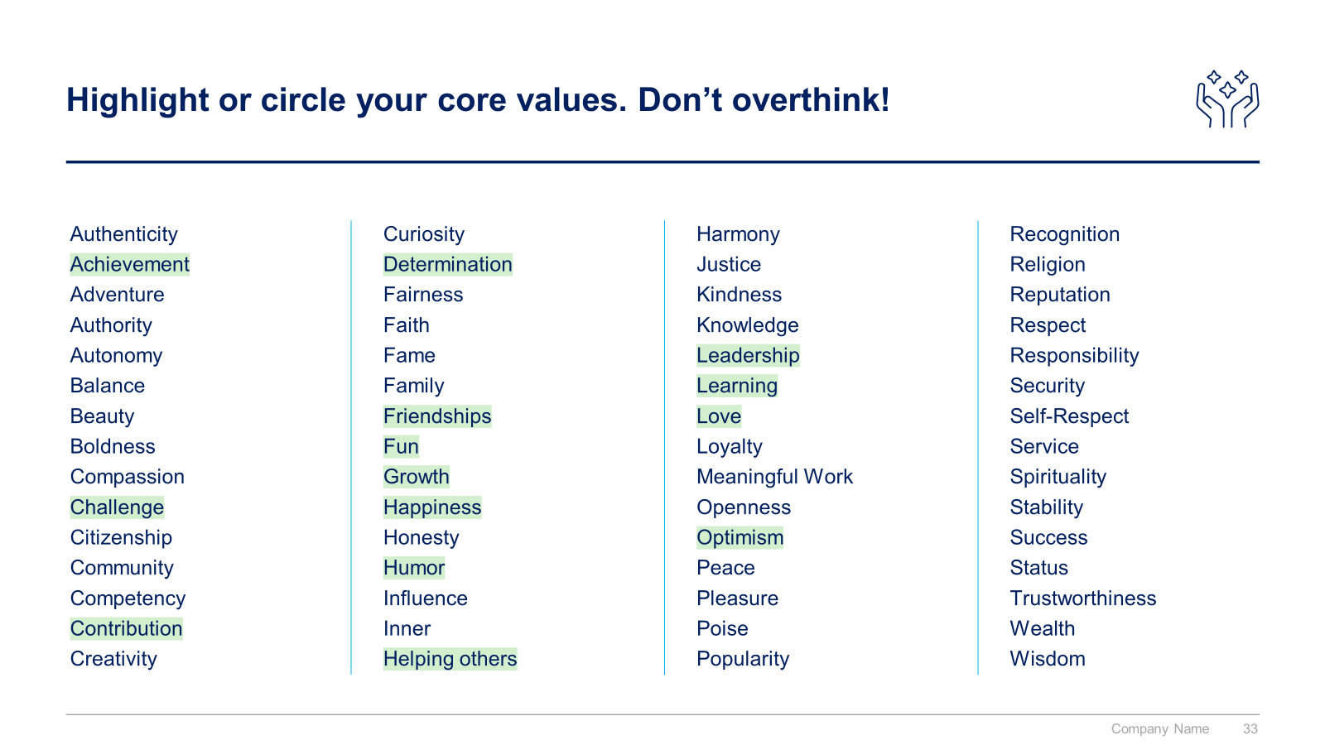
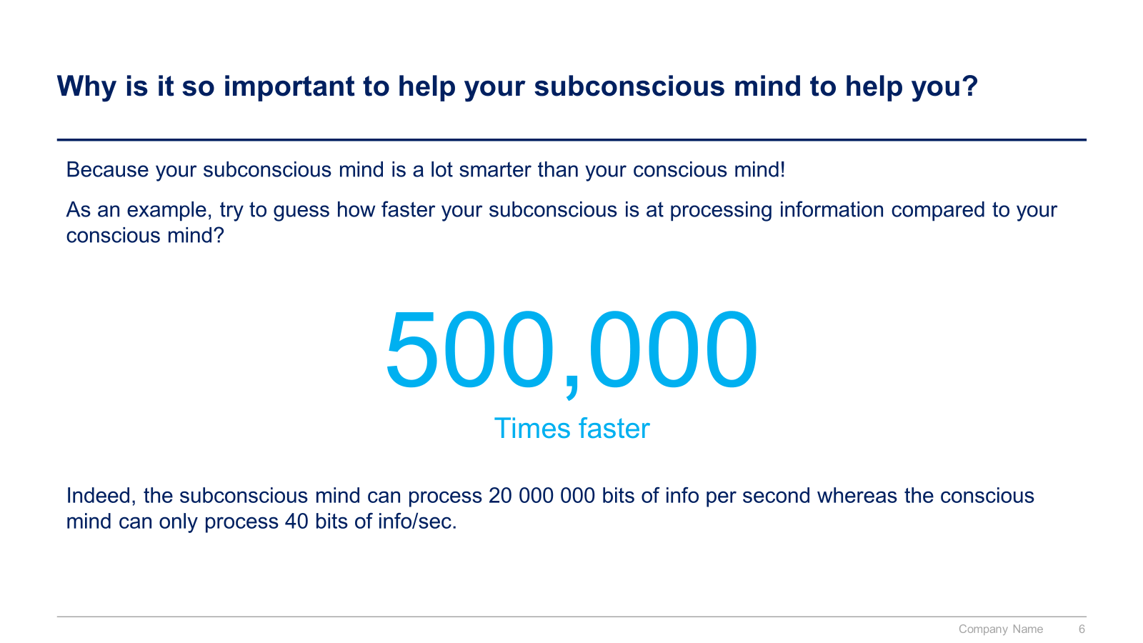
Small preview of the sections “IX. Define your personal mission, goals and values”

Slide 14



The Toolkit includes multiple PowerPoint slides, Excel sheets and Video training that you can download on your device immediately after purchase
450 editable PowerPoint slides*
5 Excel sheets*
16 minutes of Video training
Resolve complex problems
Present with impact
Communicate effectively
Negotiate effectively
Manage your time
Manage your team
Manage your stakeholders
Facilitate meetings and workshops
Define your personal mission, goals and values
*Please note that the number of Powerpoint slides and Excel sheets listed is the number of unique slides and sheets. For example, a Powerpoint slide that has been duplicated to facilitate our clients’ understanding only counts for one slide

Slide 15









Our Management Consulting Toolkits include 9 key benefits
Improve the growth & efficiency of your organization by leveraging Management Consulting Toolkits created by ex-McKinsey, Deloitte & BCG Consultants.
Make a great investment for your career & organization. It cost us US$8M+ over the past 10 years to create all our Toolkits. Get them for a fraction of this cost.
Get a competitive advantage. It’s like hiring Management Consultants to create all the practical Frameworks, Tools & Templates you need.
Get the job done quicker and never start from scratch again with our ready-made and fully editable Frameworks, Tools & Templates in Powerpoint & Excel.
Don't reinvent the wheel. We have already worked 30,000+ hours over the past 10 years to create all the Management Consulting Toolkits you need.
Improve the capabilities of your organization by learning how the Fortune 100 and Global Consulting Firms do it.
Decrease your costs. Hiring tier-1 Consultants for a project would cost you $300k+. Way more expensive than our Toolkits, which will last you a lifetime!
Become your organization’s subject matter expert and impress your stakeholders with world-class approaches to resolve common business problems.
Get free support and advice from our ex-McKinsey, Deloitte & BCG Management Consultants.

Slide 16
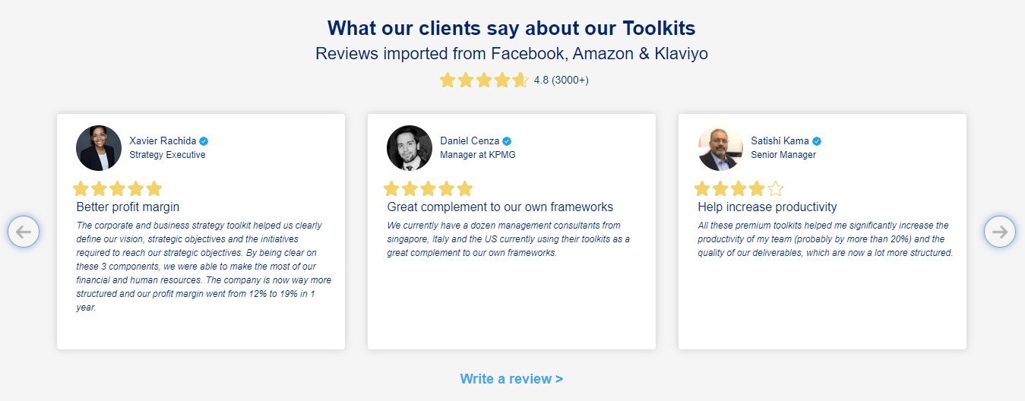
What our clients say about our Toolkits
Click here to see more reviews >

Slide 17

Join 200,000+ Executives, Consultants & Entrepreneurs leveraging our Toolkits to improve the performance of their organization
Trusted by small and large organizations
Customer satisfaction
4.8
Number of countries leveraging our Toolkits
160+
Number of professionals leveraging our Toolkits
200,000+
Daily rate of our ex-McKinsey, Deloitte and BCG Management Consultants
$3k-$4k

Slide 18

Interested in more than 1 Toolkit? Access all our Toolkits for half the price with our Gold Access
Gold Access
Click here to learn more

Slide 19
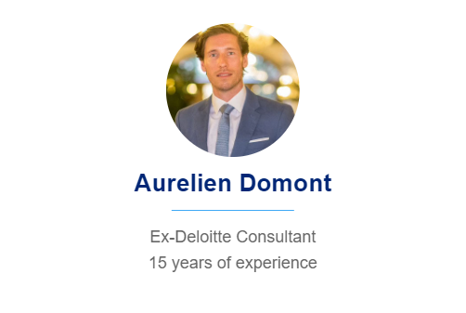
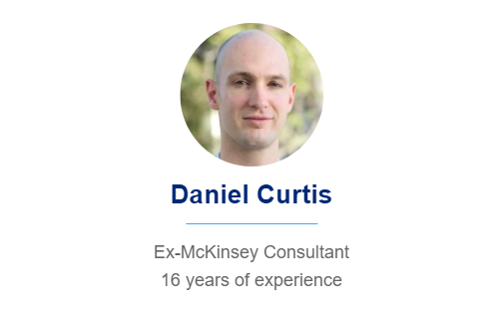
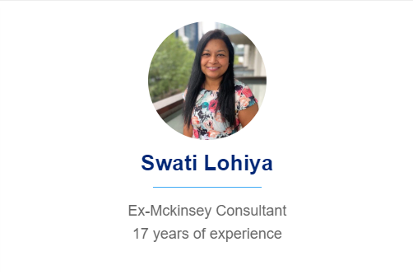
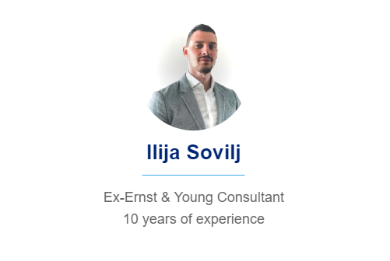
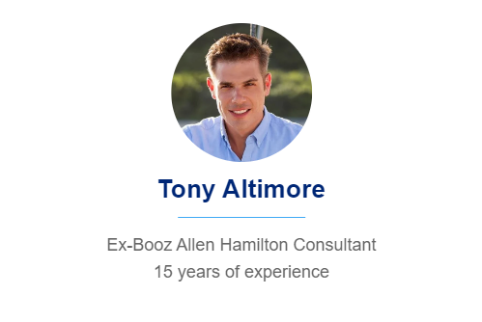
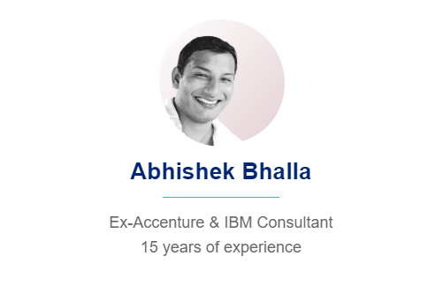
Need additional help? Send us a brief and we’ll find you the right talent from our network of 500+ tier-1 Management Consultants
Click here to send us a Project Brief

Slide 20

This was just a small preview.
www.domontconsulting.com

